Slide 1
Office 365 Development

Slide 2
Getting started with the Microsoft Graph API

Slide 3
Agenda
Intro to the Microsoft Graph API
Getting started
Demos

Slide 4
Developer vision

Slide 5
1
Intro to the Microsoft Graph API

Slide 6
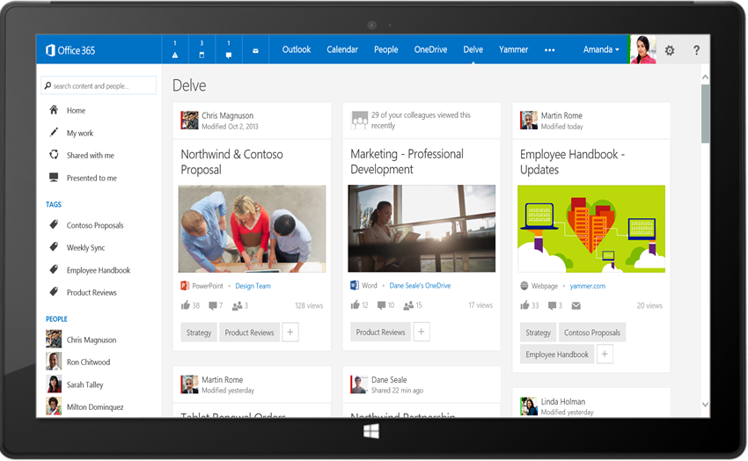
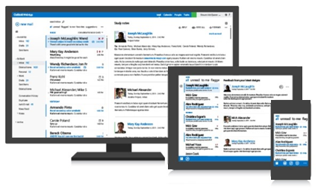




Office 365 Microsoft Graph API
Your App
https://graph.microsoft.com/
USERS
GROUPS
FILES
MAIL
CALENDAR
TASKS
Insights and relationships from Office Graph

Slide 7
Microsoft Graph API endpoint
Single resource that proxies multiple Microsoft services
Allows for easy traversal of objects and relationships
Simplifies token acquisition and management
Eliminates the need to traditional discovery (using “me” and “my organization”)

Slide 8
Office 365 direct API endpoints
Direct API endpoints for all the Office 365 Services may also be invoked
Outlook, OneDrive, OneNote, etc.
Direct endpoints have new functionality before it is exposed via the Graph API
Examples:
Outlook web hooks
Time zone on calendar

Slide 9
Office 365 discovery services
Automatically determine URL of Office 365 Services
E.g., useful for finding OneDrive for Business URLs
Supports device app and website flows
Secured using Azure AD authentication
Serves information stored about services in AAD

Slide 10
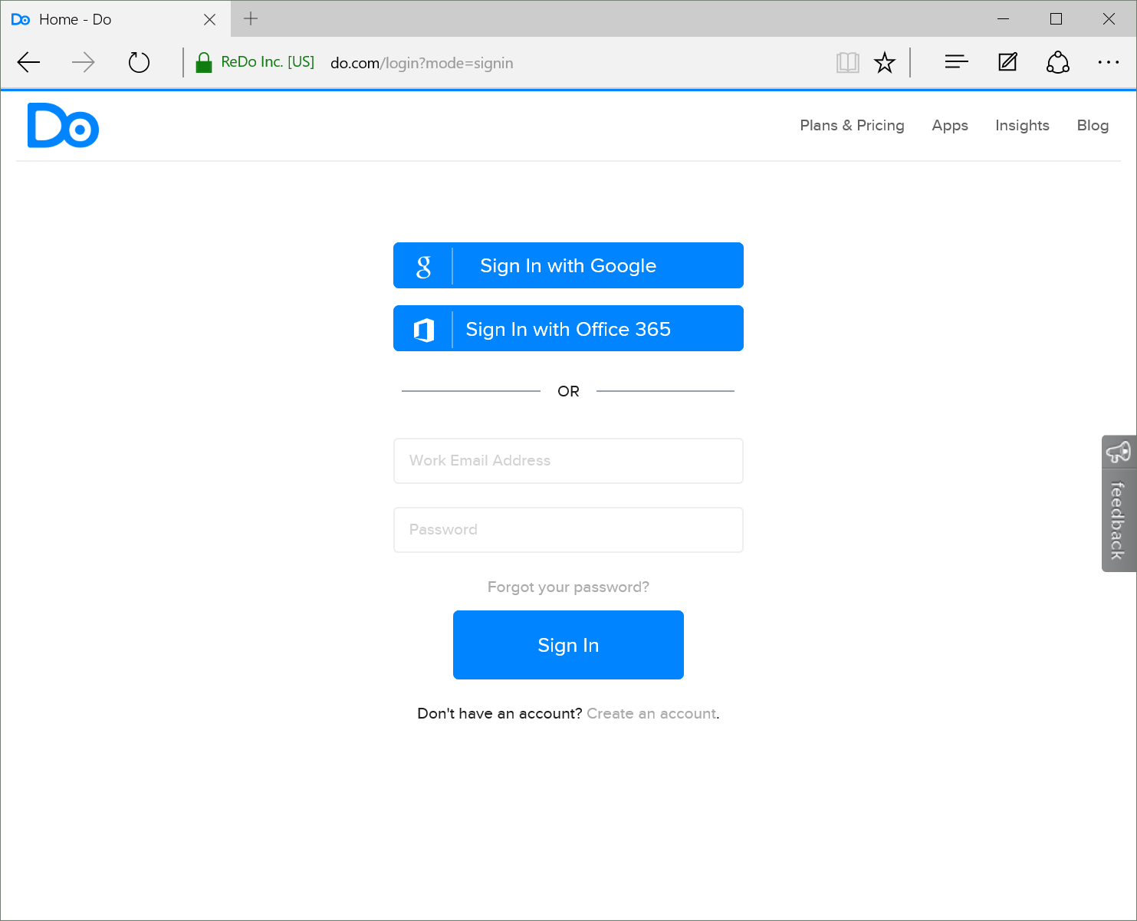
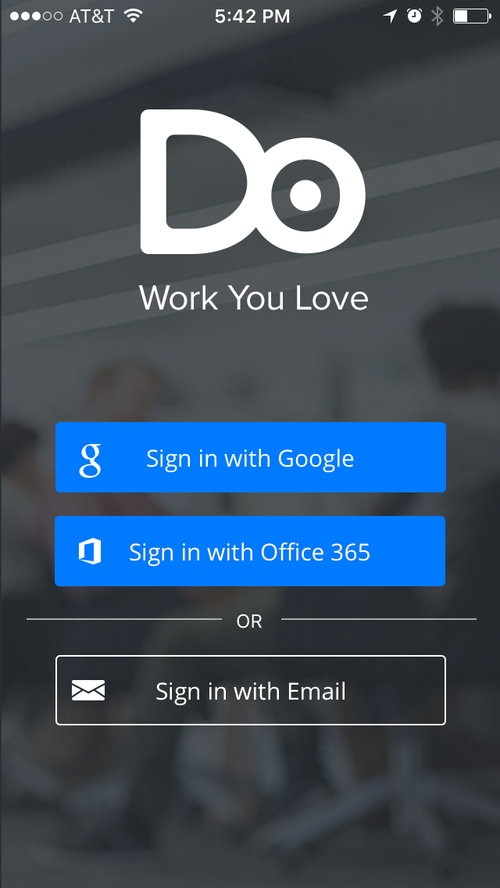
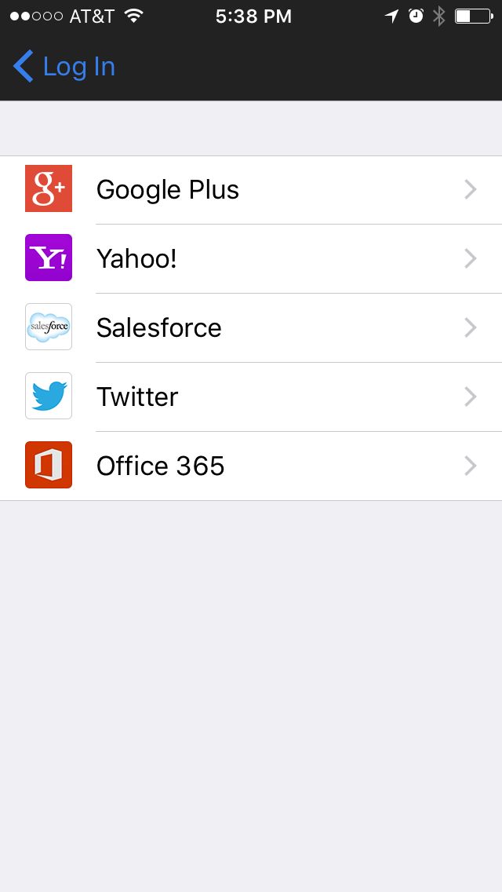
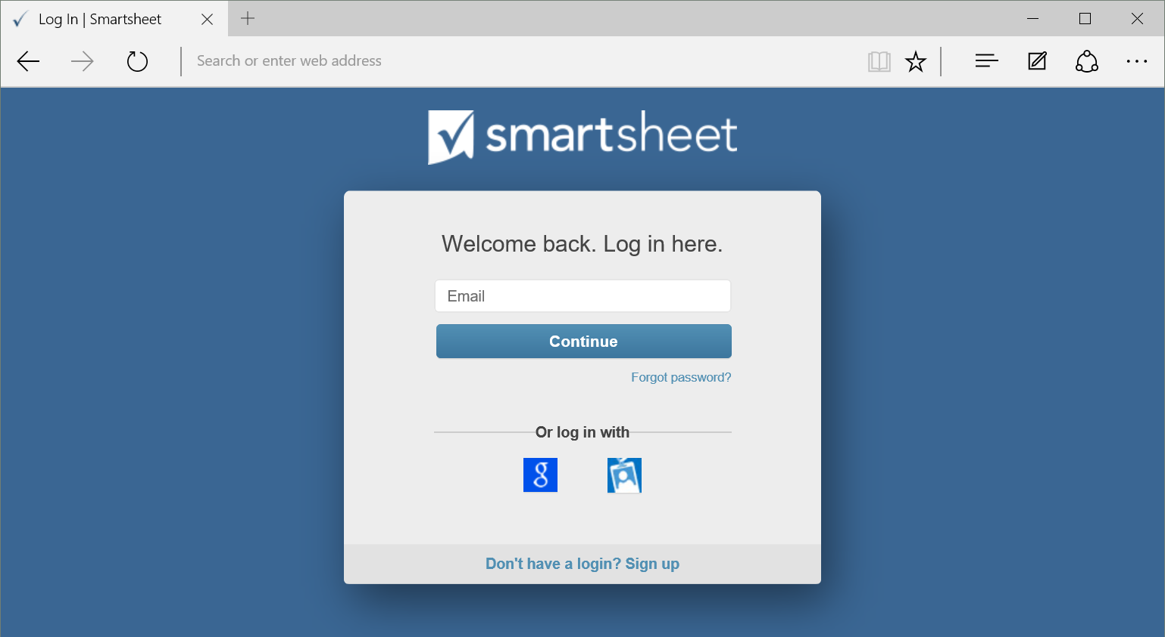
Office 365 connected apps

Slide 11
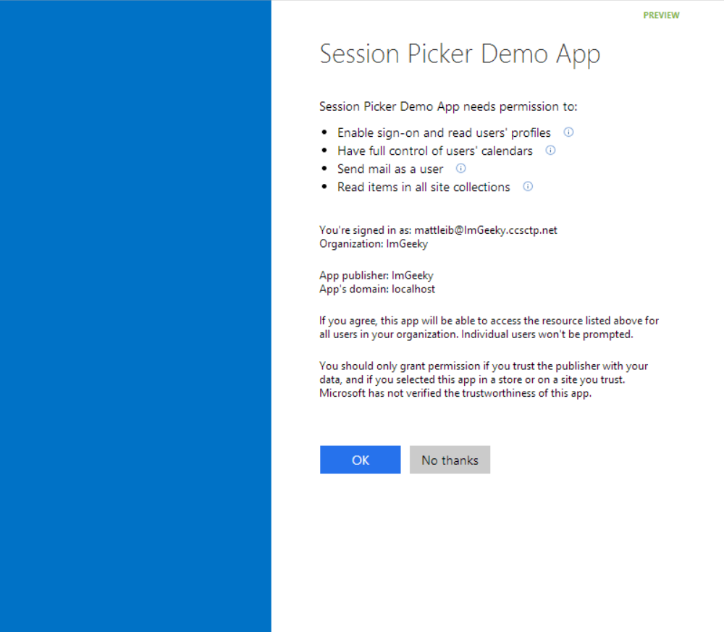
Common consent

Slide 12
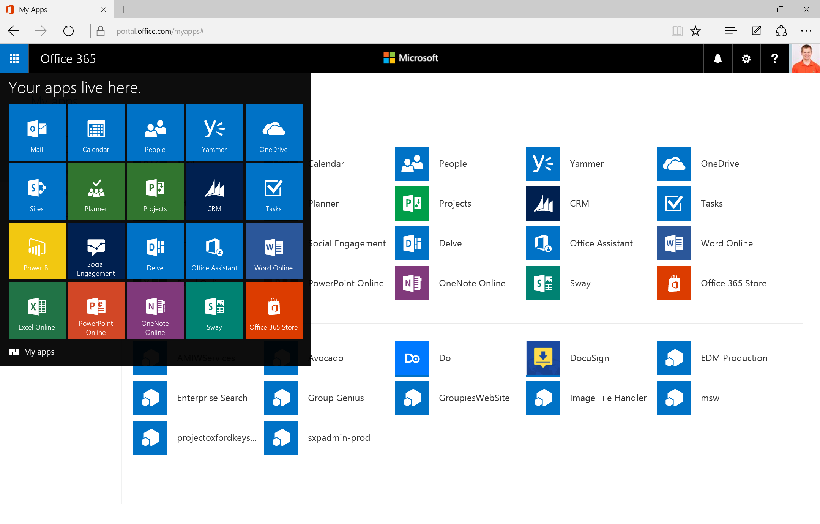
Single authentication flow for Office 365
Azure AD Graph, Exchange, SharePoint, OneNote, etc.
Device apps and standalone websites
Admin and end-user consent
Pin apps to Office 365 app launcher from My apps

Slide 13
Authentication options
Azure AD "app model v1“
Separate auth flow supports Azure AD accounts only
Azure AD "app model v2" (preview)
Converged auth flow supports Azure AD accounts and Microsoft accounts (LiveID—hotmail.com, etc.)

Slide 14
Demo Graph Explorer https://graphexplorer2.azurewebsites.net
1 Intro to Mail Add-ins
Notes:
https://graph.microsoft.com/beta/me
https://graph.microsoft.com/beta/me/manager
https://graph.microsoft.com/beta/me/messages
https://graph.microsoft.com/beta/me/events
https://graph.microsoft.com/beta/me/files
https://graph.microsoft.com/beta/me/files/{id}/createdbyuser/manager
https://graph.microsoft.com/beta/me/files/{id}/createdbyuser/manager/?$whatif
https://graph.microsoft.com/beta/myorganization/users
https://graph.microsoft.com/beta/myorganization/groups
https://graph.microsoft.com/beta/me/joinedgroups
https://graph.microsoft.com/beta/me/joinedgroups/{id}/files
https://graph.microsoft.com/beta/me/joinedgroups/{id}/conversations

Slide 15
2
Getting started

Slide 16
http://dev.office.com/getting-started
2 Getting started

Slide 17
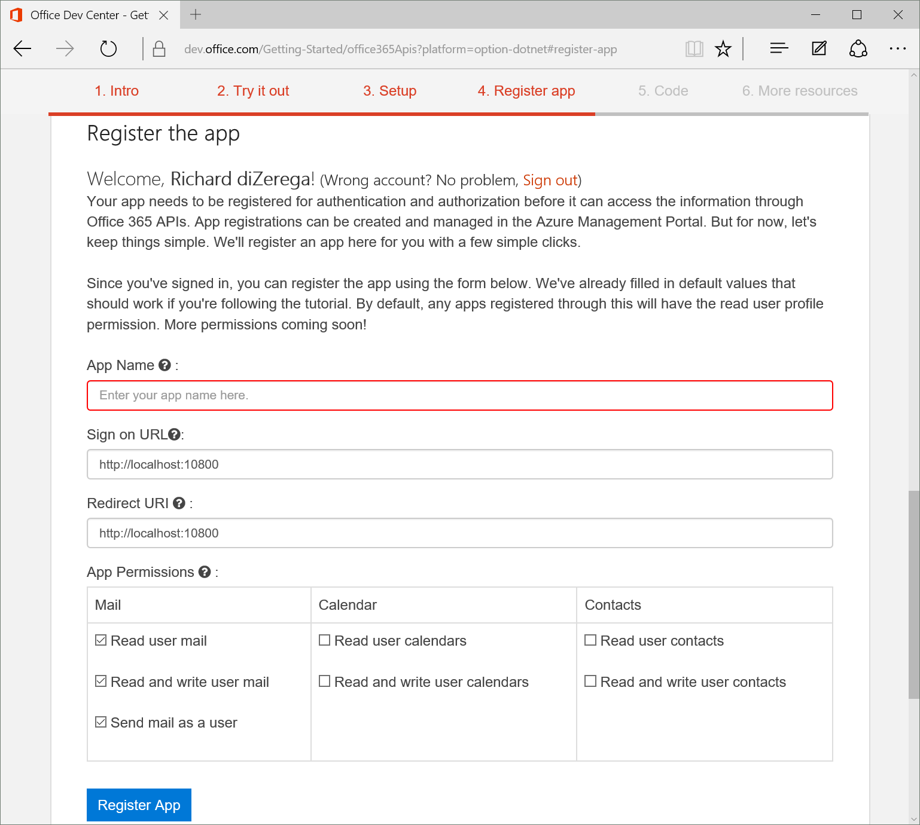
Register app from dev.office.com

Slide 18
Demo Registering application
2 Getting started
Notes:
Show app registration from http://dev.office.com/getting-started/office365apis and through azure management portal

Slide 19
First web application demo Clone/Download sample Add client ID into app.js Run demo
2 Getting started

Slide 20
Demo AngularJS HTML/JS project demo
2 Getting started
Notes:
https://github.com/OfficeDev/O365-Angular-ArtCurator

Slide 21
Summary
Intro to the Microsoft Graph API
Getting started
Demos

Slide 22
Further reading…
Getting Started with APIs
Microsoft Graph API Code Samples
Microsoft Graph API Training videos & hands on labs
Microsoft Graph API documentation

Slide 23
Developer Program Launch
1 YEAR FREE
Email Newsletters
Free Developer Subscription
Free Training
Free Tools
Webinars
http://dev.office.com/devprogram

Slide 24
Engage

